Slide 1
STUDENT RESULT MANAGEMENT SYSTEM
MADE BY-:
JAYSHREE UPADHYAY

Slide 2
OVERVIEW
A student result management system created using Python libraries like Tkinter, SQLite3, and Pillow is a software application that facilitates the efficient management and tracking of student academic results. The system allows administrators to input and store student information, including their names, grades, and other relevant data. It provides a user-friendly graphical interface designed with Tkinter, enabling easy navigation and interaction with the system. The use of SQLite3 allows for secure and efficient storage and retrieval of student data. Additionally, the Pillow library is employed to handle image processing tasks such as displaying student photos. Overall, this system streamlines the process of managing student results, making it convenient for administrators to track and update academic information accurately.

Slide 3
TECHNOLOGIES USED
This project is purely a python based. In python following libraries were used-:
Tkinter: In built python module for creating GUI apps.
Sqlite3
Pillow

Slide 4
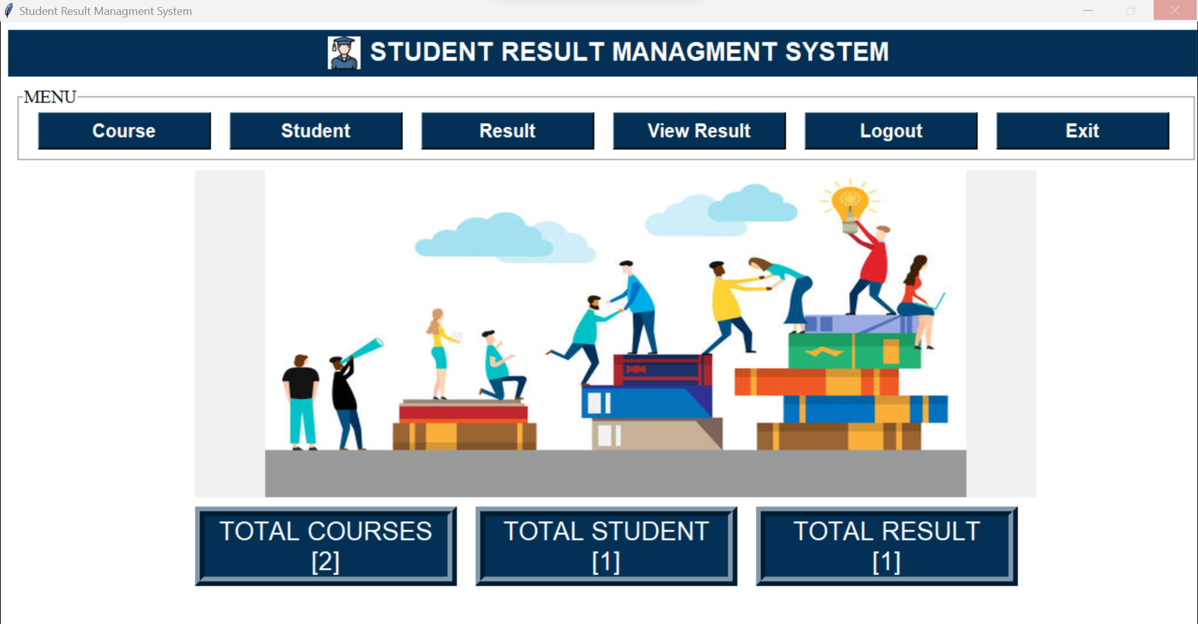
DASHBOARD

Slide 5
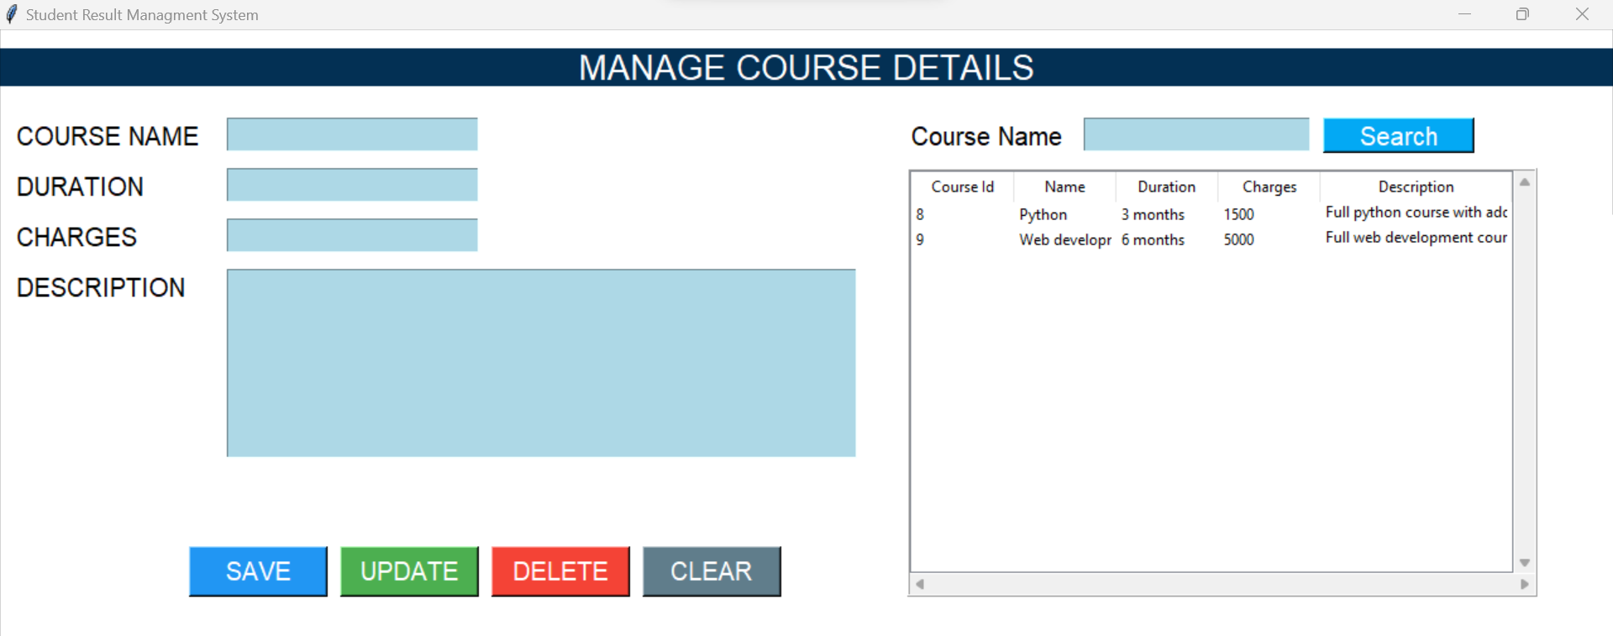
COURSE

Slide 6
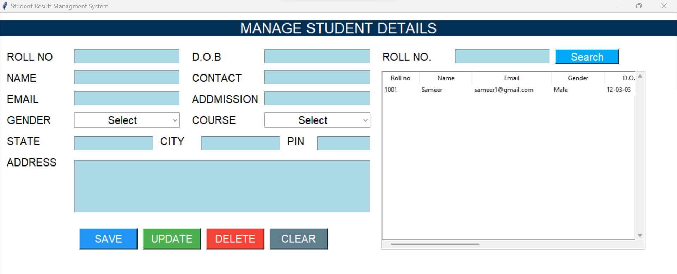
STUDENT

Slide 7
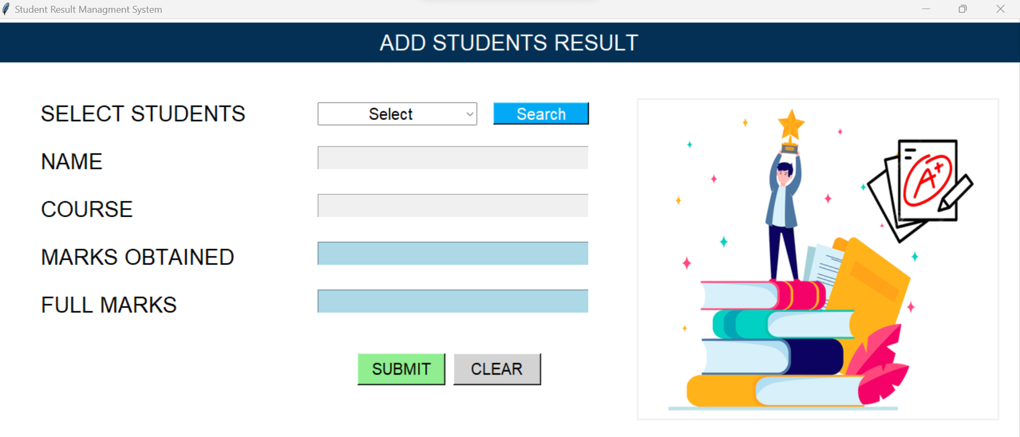
RESULT

Slide 8
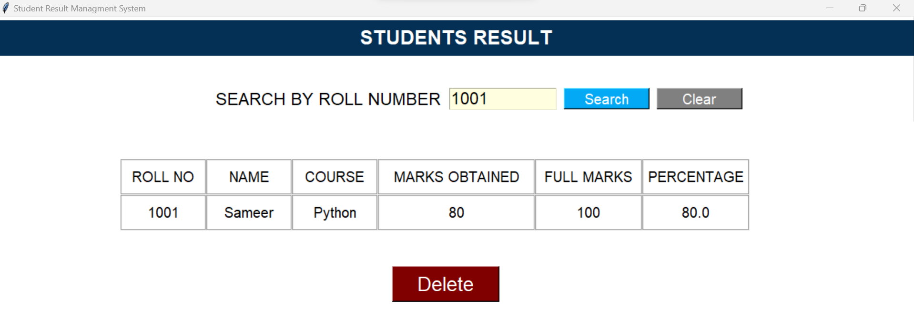
REPORT

Slide 9
THANK YOU….

